Slide 1
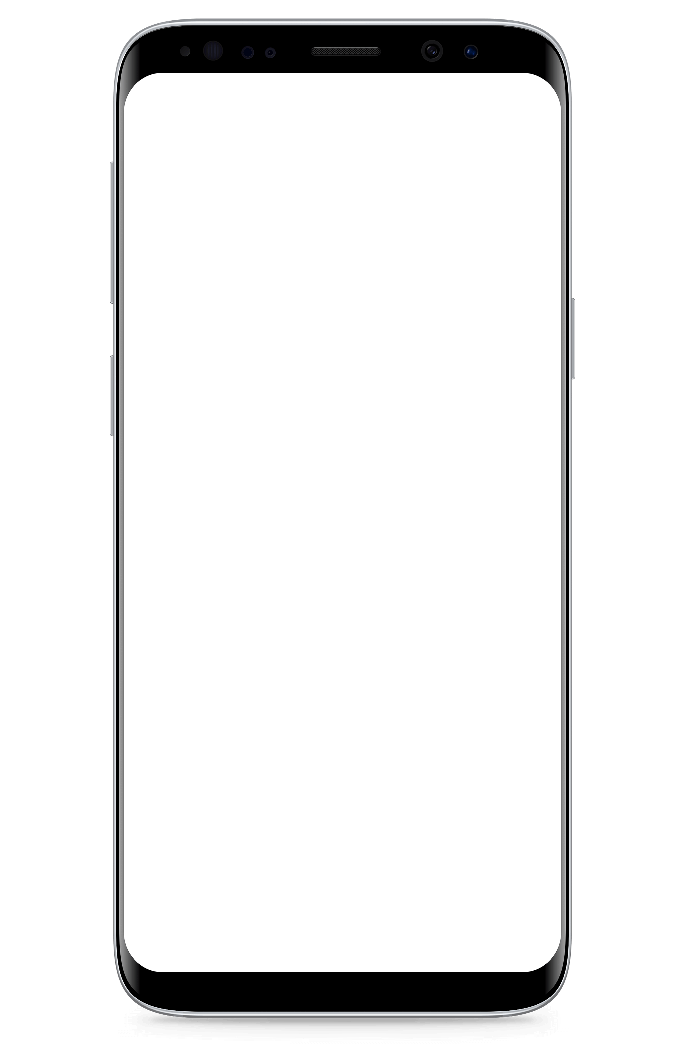


„Wo ist die Hefe?“
Team Awesome - IT Schwarz
woistdiehefe.latai.de
2

Slide 2
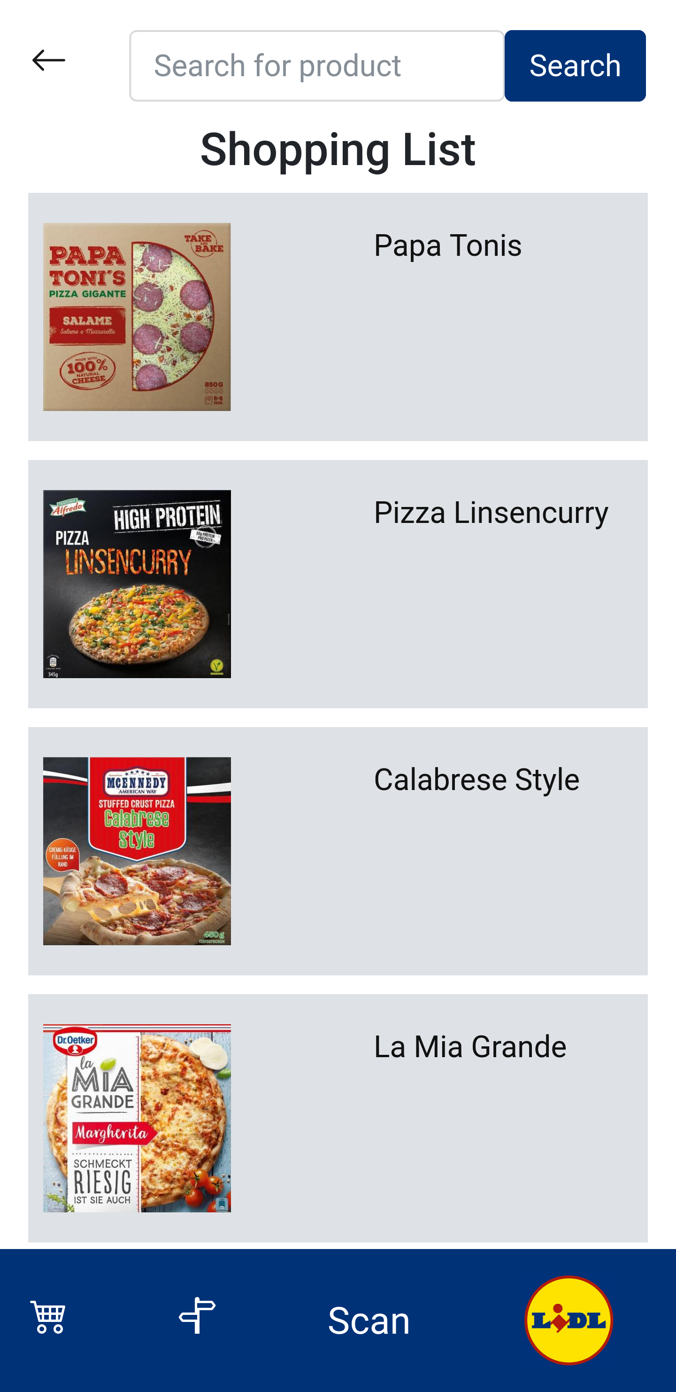
Lidl Plus² - shopping list
recommends products
from previous shopping trips,
fitting products
learns buy-rhythm for future recommendations
filters out known allergies and incompatibilities
adds products that you scan with your phone
2

Slide 3
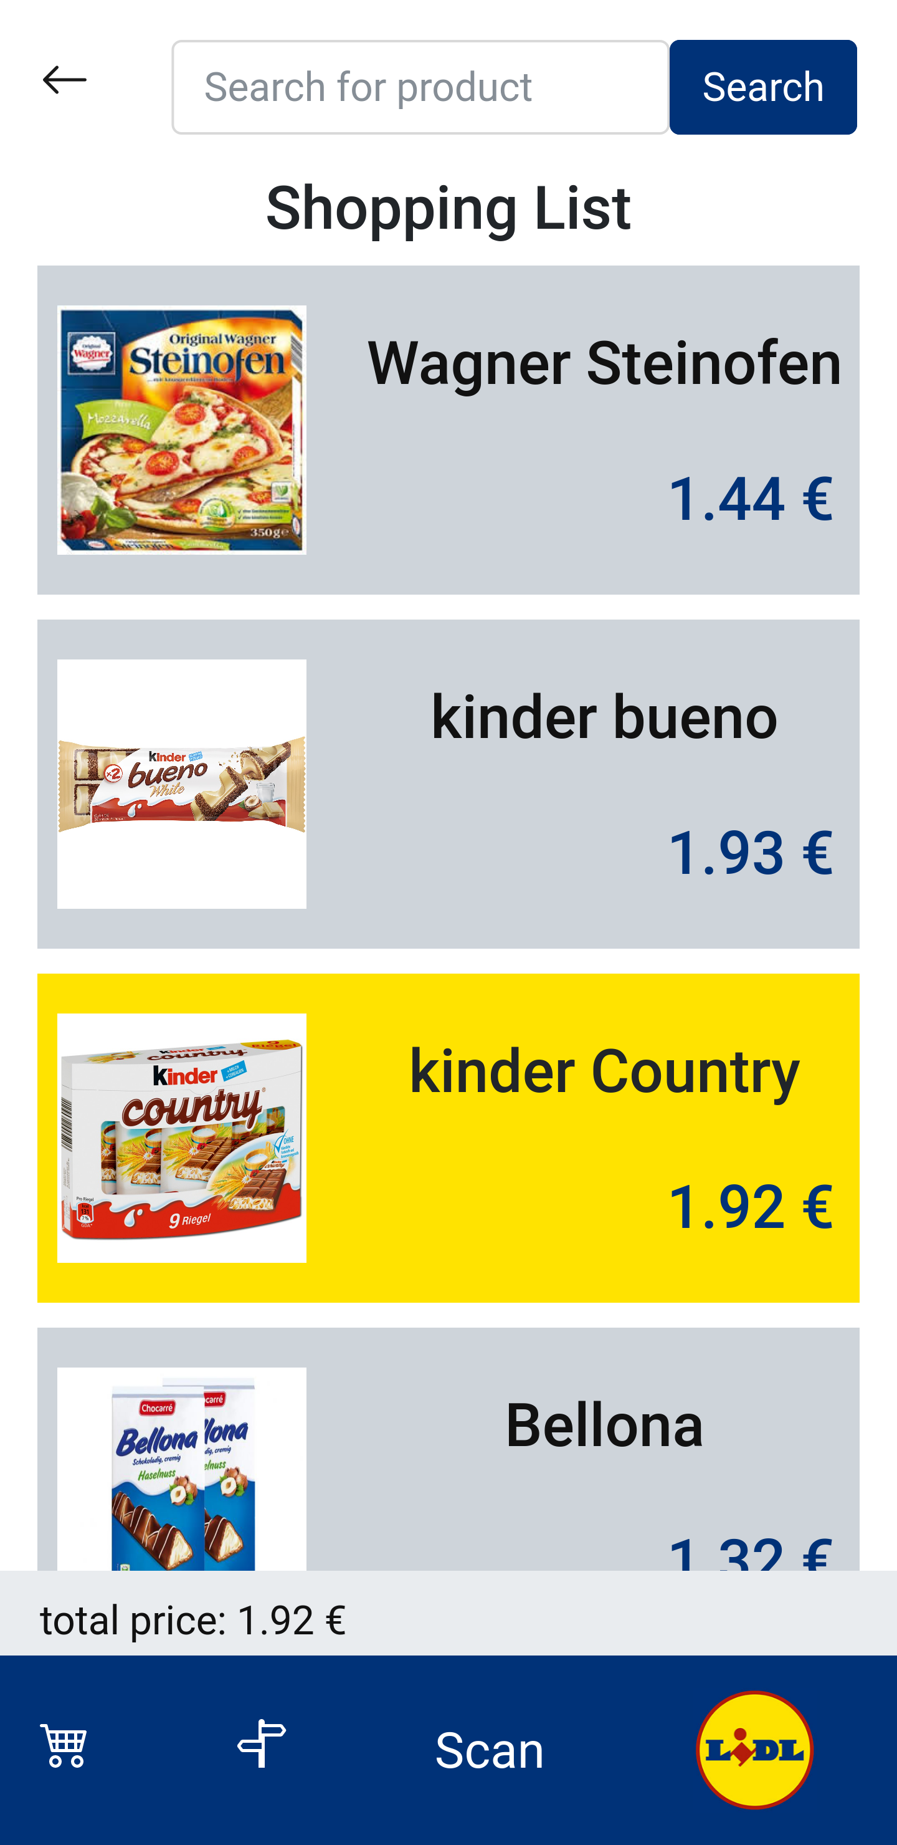
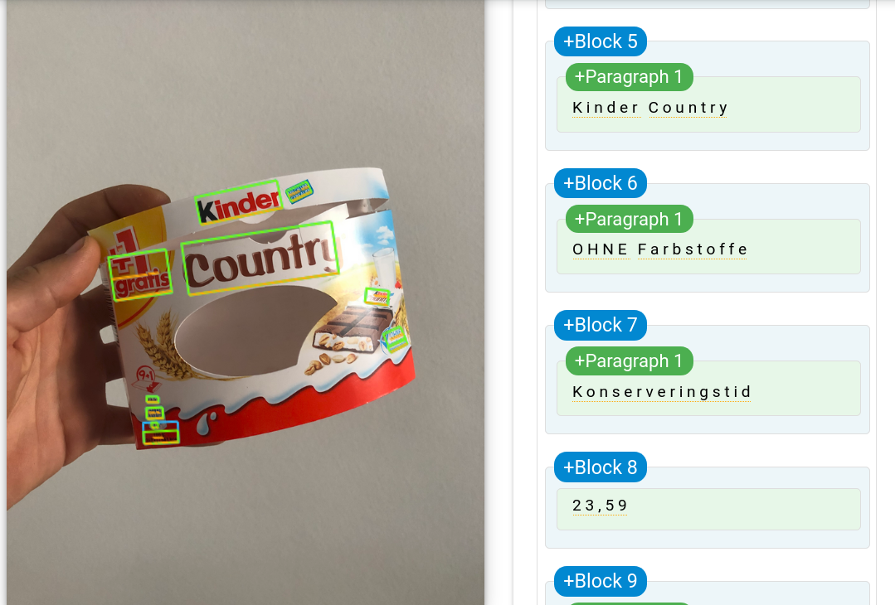

Lidl Plus² - easy item adding to shopping list
add to Shopping List
2

Slide 4
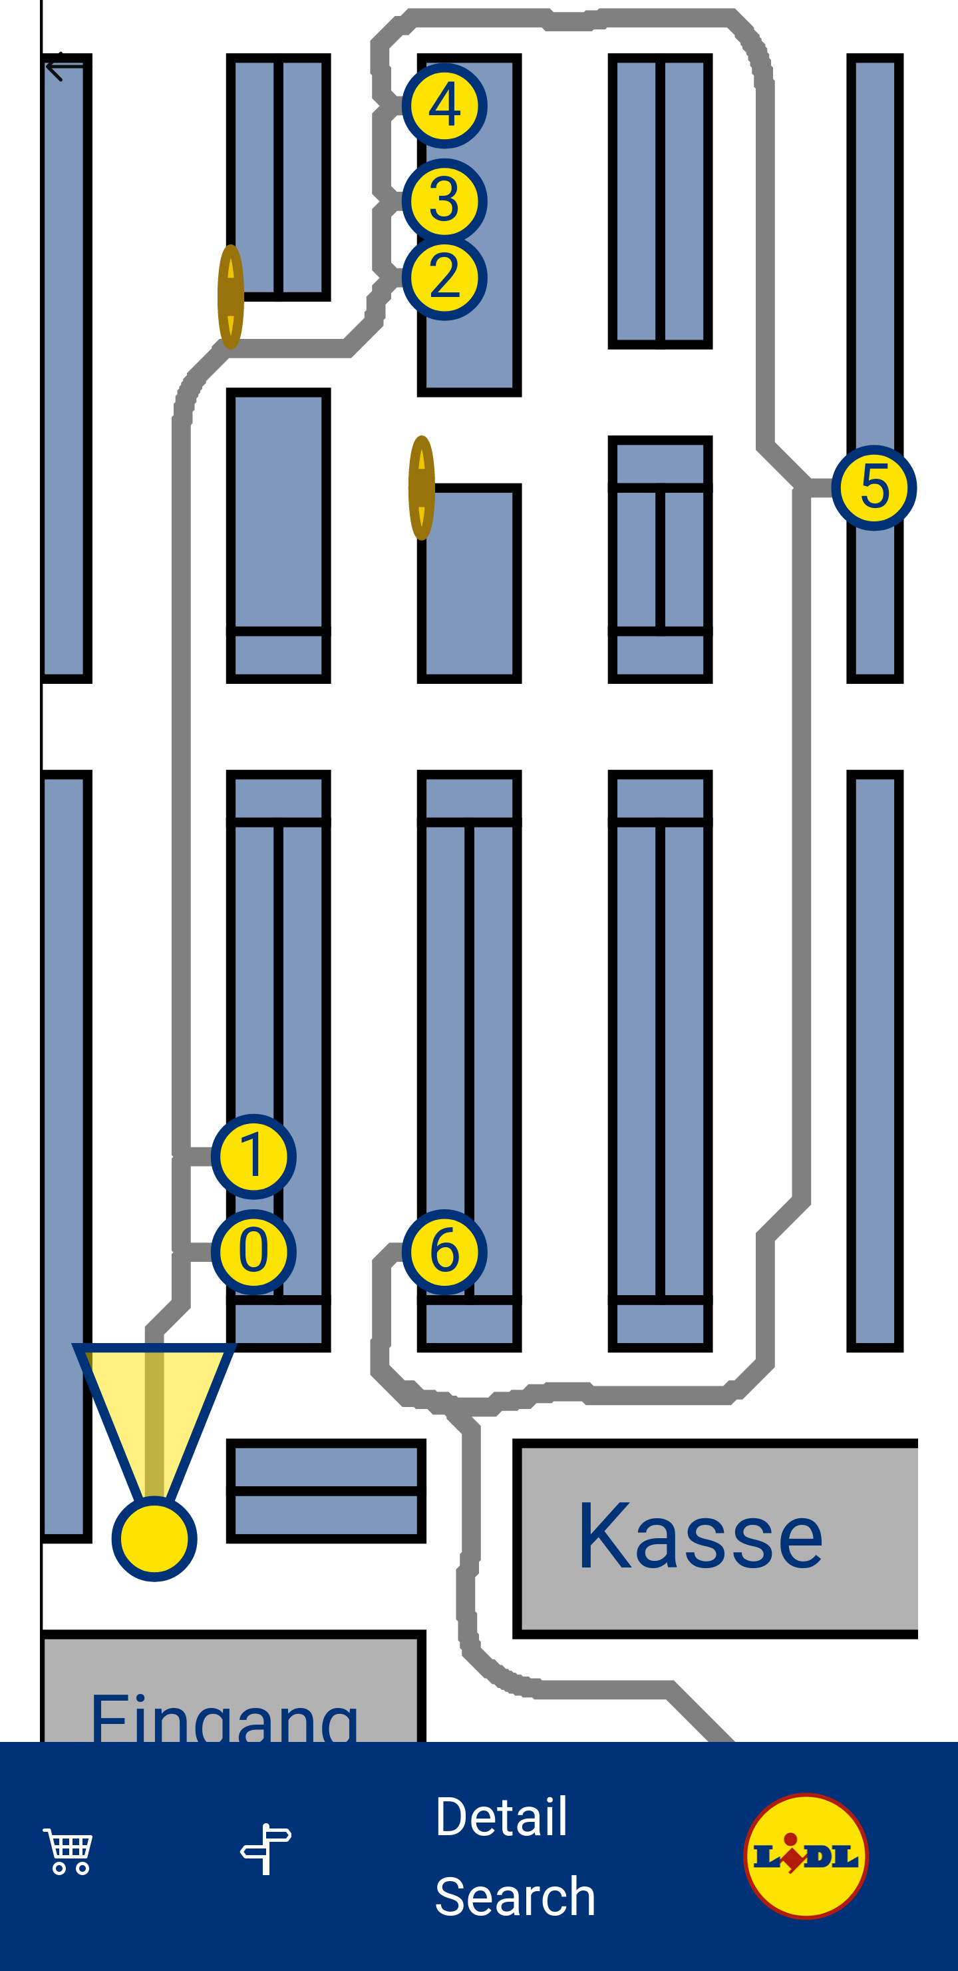
Lidl Plus² - navigator
calculates shortest route to collect all products (travelling sales man - optimization)
localization without any extra device:
gyro detects steps to measure distance
compass detects direction of view / movement
references itself when items are scanned
shows special offers along the route
includes „hidden“ specials (shopping experience gamification)

Slide 5
Lidl Plus² - scan to find
scan shelf to find product
OCR scans codes of price tags to reference position in market
indicates user where searched device is

Slide 6
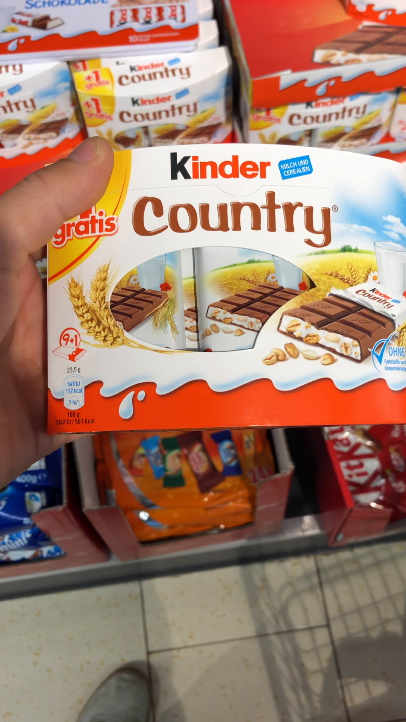
Lidl Plus² - scan to buy
scan to buy
scan device to pay on the spot
reduces shopping time
reduces cashiers at checkout
stores all invoices in the app
weight checking at check-out, to verify that all items were scanned
2
2

Slide 7
Lidl Plus² - already implemented
add items to shopping list
optimized route planing
compass for indoor localization
scan random product to reference position
scan random product to get direction to searched product

